Slide 1
Edexcel A2 Business
2.4.4 Quality management
Revisionstation

Slide 2
Worksheet

Slide 3
From Edexcel
a) Quality:
control
assurance
circles
Total Quality Management (TQM)
b) Continuous improvement (Kaizen)
c) Competitive advantage from quality management

Slide 4
Starter
If you were going to improve your day today – how would you do it?
Ask around, how would others suggest you improve your day.
Notes:
Suggestions: Stay in bed, have food delivered to school / college, it be next year and have passed, boots that fly, a car etc could be anything. When they discuss as a group they are a quality circle.

Slide 5
Does quality matter?

Slide 6
Definition: quality
Quality is how well a product or service does what it was designed to do
How well a car handles when it is driven
How tasty and hot a cup of coffee is
How well all the apps and features of a mobile phone work
How well a gardener cuts the lawn
Real quality is consistency, so every time you get a coffee from StarCosta it is hot and tasty

Slide 7
Quality

Slide 8
Quality control – detecting faulty output
Quality control is the traditional way of managing quality
Quality control is concerned with checking and reviewing work that has already been done
For example, quality control includes:
Inspection
Testing
Sampling
Quality control is mainly about "detecting" faulty output - rather than preventing it
Quality control can also be a very expensive process.

Slide 9
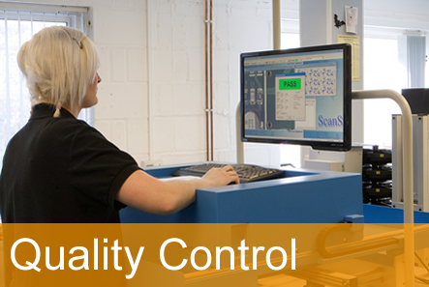
Examples of Quality control
May involve sampling or looking at data about the product to see if quality is consistent
With quality control the quality is inspected into the product or service
How might a cinema or a restaurant carry out quality control?
Notes:
Check the toilets

Slide 10
Quality Assurance – quality designed in
Quality assurance is about how a business can design the way a product of service is produced or delivered to minimise the chances that output will be sub-standard
The focus of quality assurance is, therefore on the product design/development stage
Why focus on these stages?
If the production process is well controlled - then quality will be "built-in“
If the production process is reliable - there is less need to inspect production output (quality control)

Slide 11
Quality Assurance – quality built in
Quality assurance builds quality into every stage of the production process, not left until the end
Every worker is responsible for making sure that the work they do meets quality standards
More time consuming for the workers
Each worker may have different standards; therefore no consistency
Can you compare this with quality control?

Slide 12
Comparison of quality control and quality assurance
Quality Control
Quality Assurance

Slide 13
Comparison of quality control and quality assurance
Quality Control
Quality Assurance
Quality control looks at the results of the production process and checks that the quality is consistent
QC is designed to inspect the product and correct any faults or defects which is regarded as being reactive
Aim of QC is to detect faults before it is sent for sale
The quality is built into every aspect of the product or service
The QA system is designed to prevent quality faults and defects from occurring and so is regarded as being proactive
Aim of QA is to improve the design and development of the products so that there are no faults or defects in the production process

Slide 14
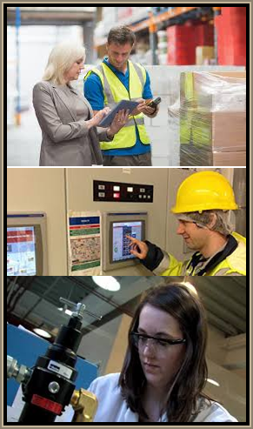
Total Quality Management (TQM)
TQM stands for Total Quality Management
TQM is a management approach change in business culture that puts quality at the heart of everything in the business.
In essence its “getting it right first time every time”
It includes a customer concept that puts the customer first

Slide 15
TQM – reducing waste
Quality management is intended to reduce wastage as well as increase the quality of the finished products
TQM places the responsibility of quality with every employee in the business
TQM includes Kaizen which means continuous improvement

Slide 16
TQM – impact of inputs on quality
Total quality means the business looks at all inputs, human resources, engineering, production, service, distribution, sales, finance, and their impact on the quality of all products or services that the business produces
TQM can improve processes and profits of a business

Slide 17
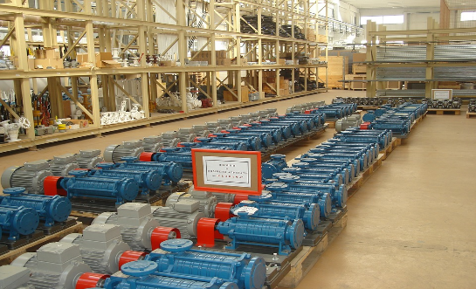
TQM
Disadvantages
Takes time to introduce
Some staff can be resistant to change
Will cost to train staff
Defects may not be spotted until the end which can be expensive e.g. mobile phones
Advantages
Not paying for inspectors
Empowered employees are motivated (esteem needs met)
Improved quality therefore more satisfied customers
Enhanced reputation
Builds good partnerships with suppliers
More involved workers
Less development time for new products

Slide 18
Quality circles
A quality circle is a group of employees who meet on a regular basis to talk about quality problems that are relevant to the part of the production process that they work on
They are joined by employees from engineering, sales and marketing and quality to make sure they are producing products that satisfy their customers

Slide 19
Quality circles – how it works
Quality circles are part of Japanese manufacturing techniques
Quality circles are usually 6-7 employees, with one coordinator
All members ideas are listened to in the quality circle
They look for solutions to problems such as; cost reduction, improved customer satisfaction, meeting a tight delivery schedule or reducing customer complaints

Slide 20
Suggested activity – form a quality circle
In small groups of 6 or 7 form a quality circle
Elect a coordinator
Decide which aspect of school or college life you would like to improve e.g. school hours, uniform, canteen etc.
Hold a quality circle meeting and make sure that the views of everyone are heard
Discuss at the end how this would be better than quality control

Slide 21
Continuous improvement (Kaizen)

Slide 22
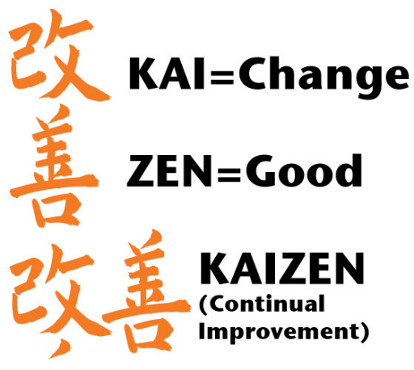
Kaizen
Kaizen is a Japanese word and it means – continuous improvement

Slide 23
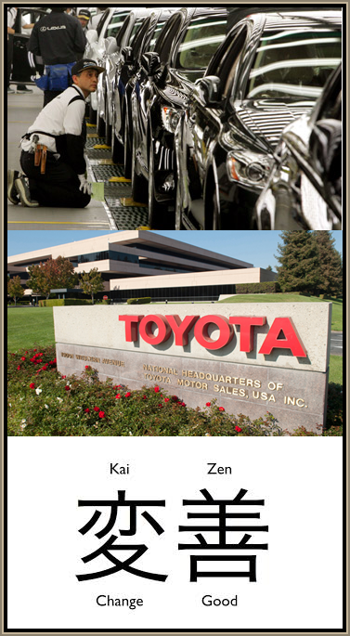
Kaizen - A Japanese approach to management
Kaizen , or Continuous Improvement is a policy of constantly introducing small incremental changes in a business in order to improve quality and/or efficiency. The Western model is to make large one off improvements for example to install a new machine or deep clean of a kitchen.
This approach assumes that employees are the best people to identify room for improvement, since they see the processes in action all the time

Slide 24
Kaizen – improvements based on small changes
Improvements are based on many, small changes rather than the radical changes that might arise from Research and Development
As the ideas come from the workers themselves, they are less likely to be radically different, and therefore easier to implement
Watch the video – can you now explain Kaizen?

Slide 25
Kaizen – responsibility of every employee
All employees should continually be seeking ways to improve their own performance
It helps encourage workers to take ownership for their work, and can help reinforce team working, thereby improving worker motivation
Can you explain how kaizen will improve employee productivity?

Slide 26
Suggested activity - Kaizen
Have a look at your morning routine (a school day) and write down a list of every single task that you complete in the morning e.g. put on shoes
Now highlight any activity that could be improved with Kaizen
Could you move your hairdryer to a better location? Could you prepare your breakfast the night before? Could you install a coffee machine in your room?

Slide 27
Competitive advantage from quality management

Slide 28
Competitive advantage through quality
A business can achieve competitive advantage through their quality
This may enable them to appear superior to their rivals in the eyes of the customers
Customers may be willing to pay more for quality
Customers may also repeat purchase products which they regard to be the best or most consistent quality
All products sold by SwissArmy365 carry a lifetime manufacturer’s warranty.

Slide 29
Sample Edexcel A2 questions

Slide 30
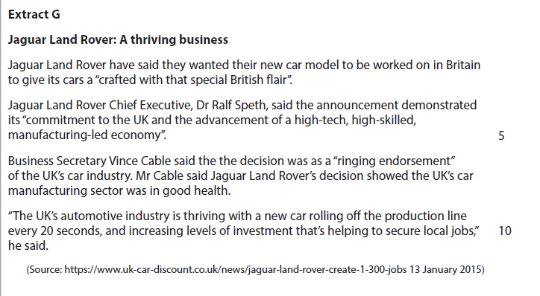
Case studies for question 1

Slide 31
Sample question 1
Knowledge 2
Application 2
Analysis
4
Evaluation
4

Slide 32
Answer sample question 1

Slide 33
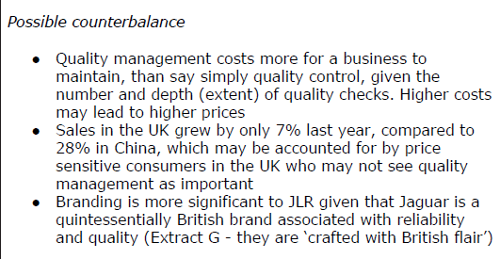
Answer sample question 1

Slide 34
Answer sample question 1

Slide 35
How to level sample question 1

Slide 36
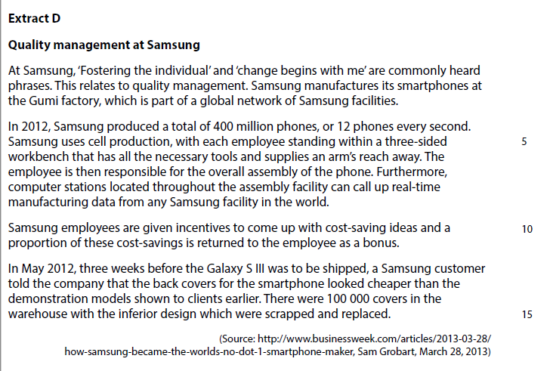
Case studies for question 2

Slide 37
Sample question 2
Knowledge 4
Application 4
Analysis
6
Evaluation
6

Slide 38
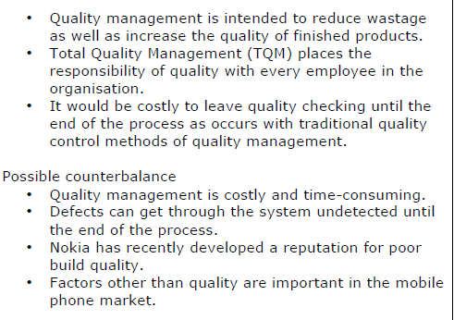
Answer sample question 2

Slide 39
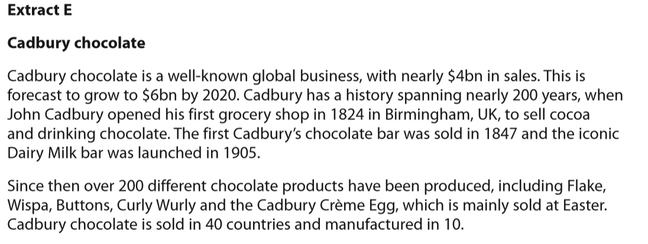
Case studies for question 3

Slide 40
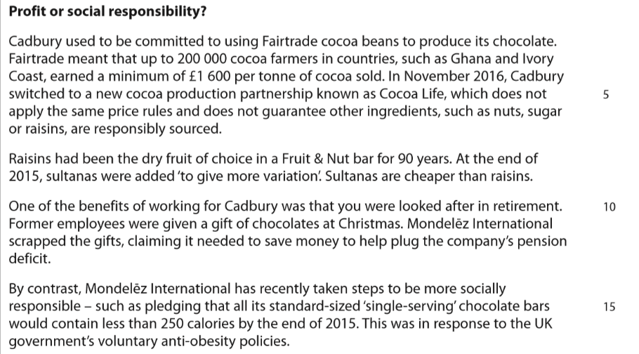
Case studies for question 3

Slide 41
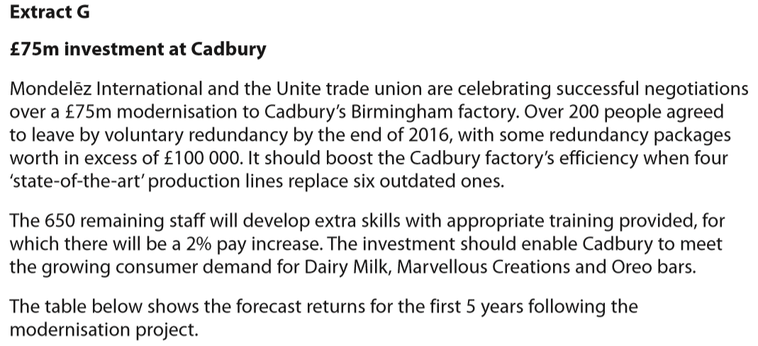
Case studies for question 3

Slide 42
Sample question 3
Knowledge 2
Application 2
Analysis
2
Evaluation
2

Slide 43
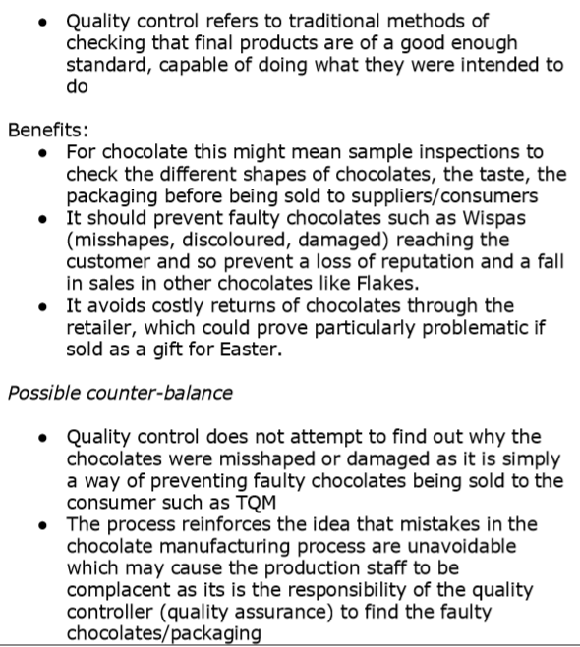
Answer sample question 3

Slide 44
Glossary
Kaizen; means continuous improvement in everything
JIT; just-in-time delivery system means a business can save money on holding stocks
TQM; Total Quality Management, a management approach to quality in everything
Quality assurance; An approach to designing a quality item for the customer from the outset
Quality control; inspecting the product at the end or part way through manufacture to check for quality
Lean production; an approach to manufacturing which aims to reduce waste in all aspects of production

