Slide 1
Edexcel A2 Business
3.4.1 Corporate influences
Revisionstation

Slide 2
Worksheet

Slide 3
From Edexcel
a) Corporate timescales: short-termism versus
long-termism
b) Evidence-based versus subjective decision making

Slide 4
Starter
After A Levels you have many choices, which will give you money in your hand the soonest?
Which option will pay the most in 5 years time?
Go into a job straight from school or college?
University?
Going into an apprenticeship?
Notes:
Probably the job but in 5 years time the graduate will emerge and earn more than the worker or the apprentice

Slide 5
Corporate timescales defined
Corporate timescales refers to strategy and the expectation of when a return will be achieved

Slide 6
Corporate timescales: short-termism versus
long-termism

Slide 7
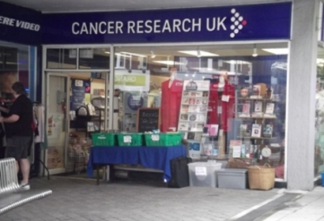
Context
Which of these is likely to be short-term and which of these will be long-term?

Slide 8
Short-termism – quick financial reward
Short-termism means that a business is only interested in a quick financial reward
For example the business may be focussed on monthly profit figures or quarterly sales figures
There are arguments that investors are only looking for short-term profit returns rather than building companies that employees can be proud of

Slide 9
Short-termism – historical roots
Short-termism is choosing a course of action which is best in the short term, but may be critical in the long-term
This comes from history where we didn’t live long enough to worry and thought just about the present – overspending, smoking and drug abuse are examples of that in modern day attitudes
CEOs in MNCs typically only last 6 years in the role*
Notes:
https://www.slideshare.net/MGHProfessional/saving-capitalism-from-shorttermism?qid=4182e859-fc2b-463f-bfaa-2428ff154797&v=&b=&from_search=4

Slide 10
Short-termism-lack of development
A short-term attitude by a business is a focus on short-term returns on investments
Instead they should be looking to invest in research projects that will give the business the competitive advantage
Short-termism makes businesses fail to innovate and stagnate (Kodak and Blockbuster)
At one point Kodak had 90% of camera film sales but its short-term view and failure to innovate meant it lost its lead in a competitive marketplace

Slide 11
Long-termism
Long-termism is a whole business approach
Incorporates CSR
Considers ethical behaviour of the business in decision making
Research and development have long term goals
Staff development is seen as a long term objective of the business, to retain and develop staff
Long-term technology investments secure data for the future

Slide 12
Evidence-based versus subjective decision making

Slide 13
Evidence based decision making
Decisions relating to the business are based on evidence and data which is valid and trusted information
Decisions should be based on a combination of critical thinking and the best available evidence
Decisions are made using evidence from multiple sources to increase the probability of a favourable outcome

Slide 14
Evidence in evidence based decision making
Evidence used in decision making in a business could be;
The outcome of scientific research e.g. use of chemicals in production processes
Organisational facts and figures e.g. annual report
Benchmarking with competitors e.g. car companies sharing ideas

Slide 15
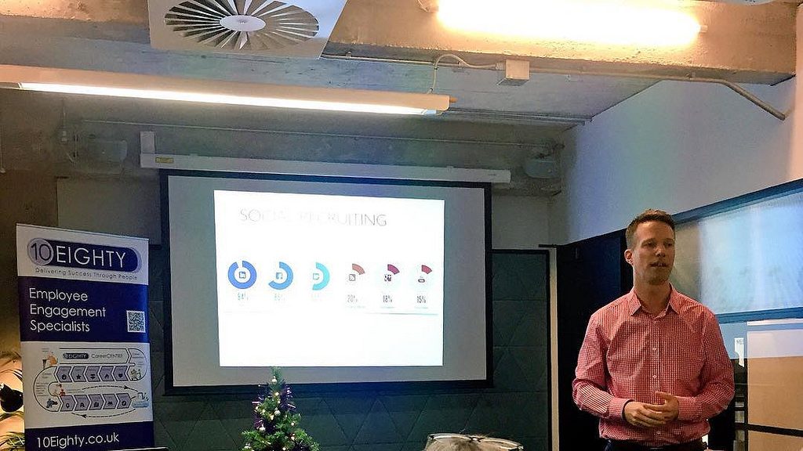
5 steps of evidence based decision making
Step 1: Ask – translate a problem into a question
Step 2: Acquire the evidence
Step 3: Appraise the evidence
Step 4: Apply the evidence to the problem
Step 5: Assess the outcome of the decision

Slide 16
Subjective decision making
Decisions relating to a business which are based on personal perspectives, feelings and opinions
Radio 4 podcast on film awards being entirely subjective decisions e.g. film industry is big business in the UK and awards may convince customers to go and see a film, but a small committee of unelected members decides who wins the BAFTAS

Slide 17
BAFTAS
“The British Academy of Film and Television Arts is an independent charity that supports, develops and promotes the art forms of the moving image by identifying and rewarding excellence, inspiring practitioners and benefiting the public.”

Slide 18
Glossary
Short-termism; a business that focuses on short-term returns on investment e.g. a start-up business’s first year’s profits
Long-termism; ability of a business to invest in projects over a long term e.g. a cure for cancer
Evidence based decision making; based on valid and reliable data e.g. we should give Shivani the job because she has smashed her last 4 targets
Subjective decision making; based on personal feelings and opinions e.g. we should give Tom the job I like him

