Slide 1
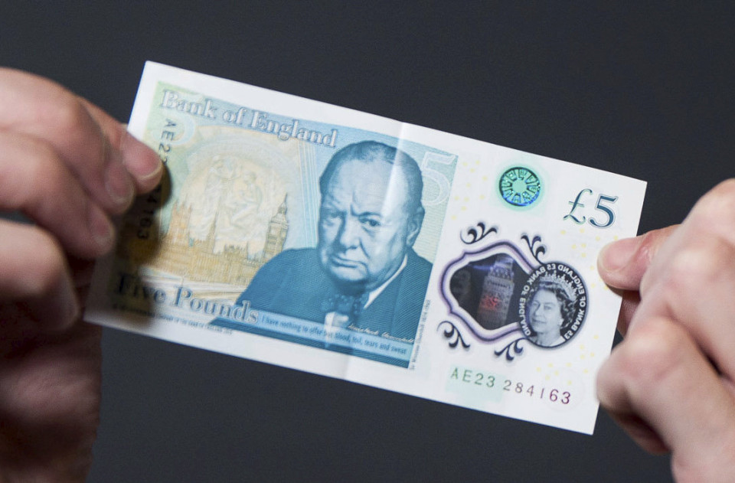
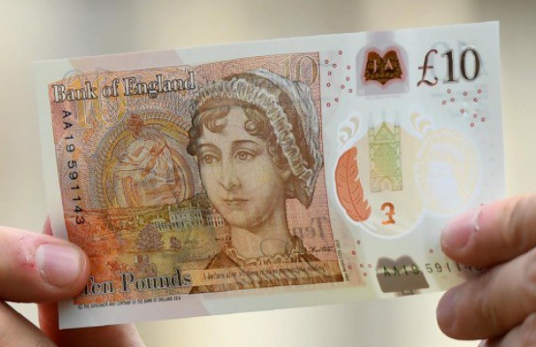
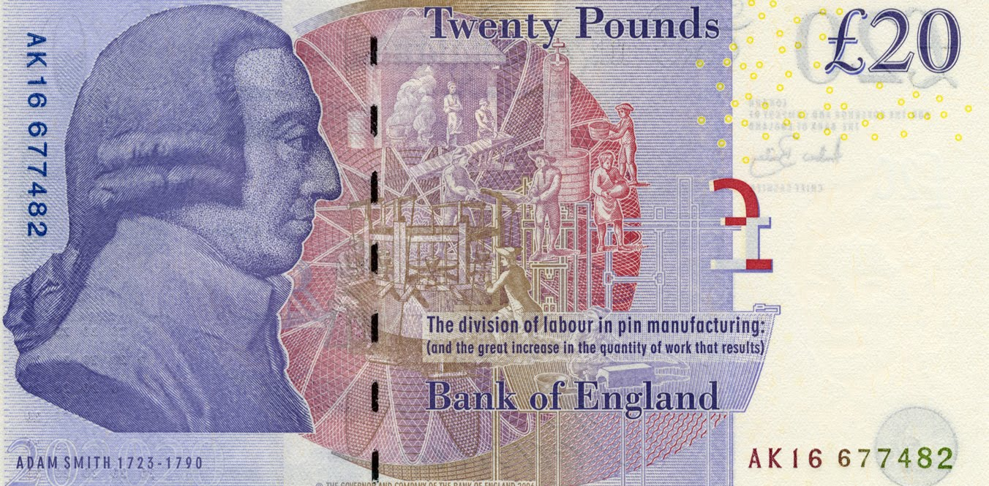
What is money… why do we need money? What would happen without it?

Slide 2
LEARNING OBJECTIVES
Lo1: Explain the functions and importance of money.
Lo2: Analyse why countries trade.
Lo3: Explain the theory of specialisation and division of labour.

Slide 3
SPECIFICATION
1.1.5 Specialisation and the division of labour
a) Specialisation and the division of labour: reference to Adam Smith
b) The advantages and disadvantages of specialisation and the division of labour in organising production
c) The advantages and disadvantages of specialising in the production of goods and services to trade
d) The functions of money (as a medium of exchange, a measure of value, a store of value, a method of deferred payment)

Slide 4
A world without money…
Economies without money would rely upon bartering systems.
They would swap goods in exchange for other goods that they wanted.
The biggest problem with this is that it relies upon the other party wanting your good.
If somebody doesn’t want your tennis racket, then you cannot get the chair!

Slide 5
FUNCTIONS OF MONEY…*
There are four main functions of money that you need to know:
Medium of exchange
Measure of value
Store of value,
Method of deferred payment.
Each group will be designated one function. Use the list of questions to explore the function and be ready to share your ideas with the class.
Complete the table provided.

Slide 6
Medium of Exchange
The most important function of money. Money is used to purchase goods and services.
A worker accepts payment in money because she knows that she will be able to use that money to buy products in shops.
There is no money in a barter economy. Exchange is conducted directly by swapping one good with another. For instance, a farmer might trade a cow in order to acquire a carpet.
This is problematic as it requires a double coincidence of wants. Which requires that each part in the transaction wants what the other party has to offer.
Notes:
https://www.youtube.com/watch?v=dI0MVV5UjKc

Slide 7
Measure of Value
Money acts as a unit of account. If a dress costs £30 and a skirt costs £15, we know that the value of one dress equals the value of two skirts.
Inflation reduces the ability of money to act as a unit of account, as the price of different goods can change by the hour in serious situation!
This becomes problematic in a bartering system, as people’s opinions of the value of certain items differ greatly. Somebody may place a greater value on the skirt and others may place a greater value on the dress.
Notes:
https://www.youtube.com/watch?v=dI0MVV5UjKc

Slide 8
Method of deferred payment
If people lend money today, they will only do so if they think that they will be able to buy roughly the same amount of goods when it is paid back.
In trade, a company which accepts an order at a fixed price today, for delivery and payment in a year’s time, will only do so if it is confident that the money it receives will have a value in the future.
This allows contracts for future transactions to be created. So again money must link the present and future when it comes to borrowed as a well as saved money.
Notes:
https://www.youtube.com/watch?v=dI0MVV5UjKc

Slide 9
Store of Value
A worker receiving wages is unlikely to spend the money immediately. They may defer spending because it is more convenient to spend later.
A worker would only do this though if they can buy in the future, approximately equal to what they can buy today. So money links the present and the future. It acts as a store of value.
For example, if somebody earns £10 and knows that they can buy two chairs today, but actually doesn’t need them until next week, they can delay the purchase of the chairs knowing full well that their £10 can still purchase two chairs in the future.
High inflation destroys this link because money in the future is worth far less than money today (they can buyer fewer chairs).
Notes:
https://www.youtube.com/watch?v=dI0MVV5UjKc

Slide 10
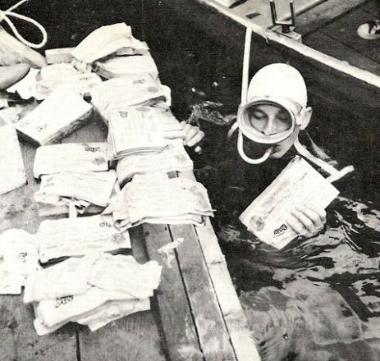
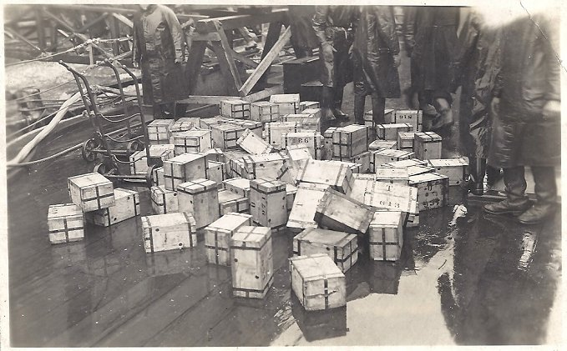
OPERATION BERNHARD
Notes:
https://www.youtube.com/watch?v=dI0MVV5UjKc

Slide 11
Example… OPERATION BERNHARD
Just like a good or service, the value of money operates on the basis of supply and demand (exchange rate – future topic).
If there is too much money (increasing supply) then the value would fall.
This can be illustrated with an interesting example of economic warfare during WW2, codenamed Operation Bernhard.
The Nazis attempted to print fake money and drop it over the UK – in an attempt to destabilise the economy.

Slide 12
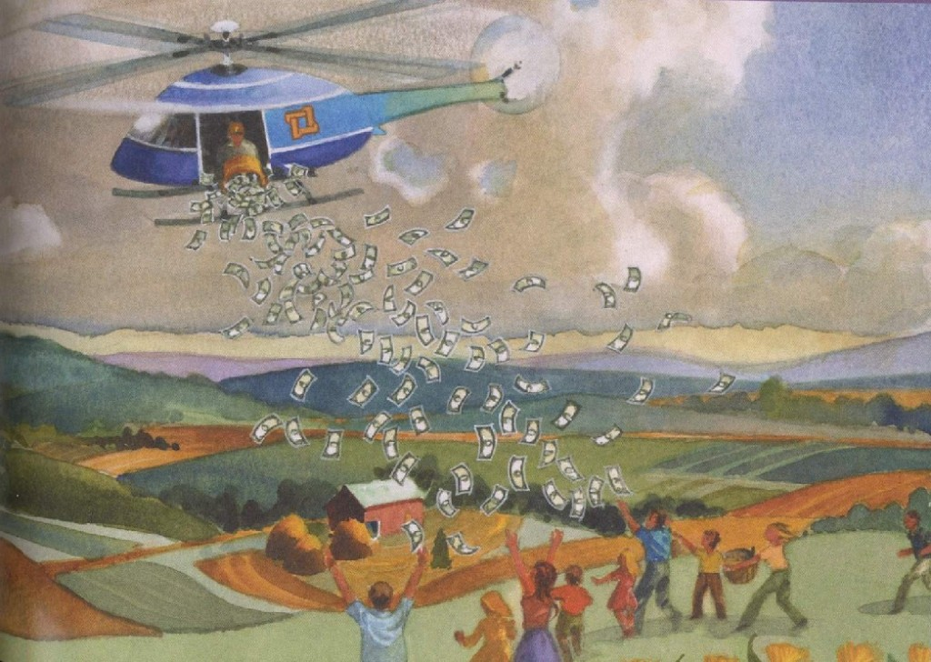
What would be the impacts of this scenario?

Slide 13
https://www.youtube.com/watch?v=FuHQhGqZvY0
– Invention of money animation (3:04)
https://www.youtube.com/watch?v=dI0MVV5UjKc
– BoE money video (2:04)
https://www.youtube.com/watch?v=2du_M8zSe3U&feature=youtu.be – Prison Money (from 0:50* - 3:18)
https://www.youtube.com/watch?v=Dugn51K_6WA
Money and Finance Crash Course (10:00) Money up to 4:50
https://www.youtube.com/watch?v=9y9R0v96K48
TEM in Greece, resorting to bartering and ‘new’ currency (2:38)

Slide 16
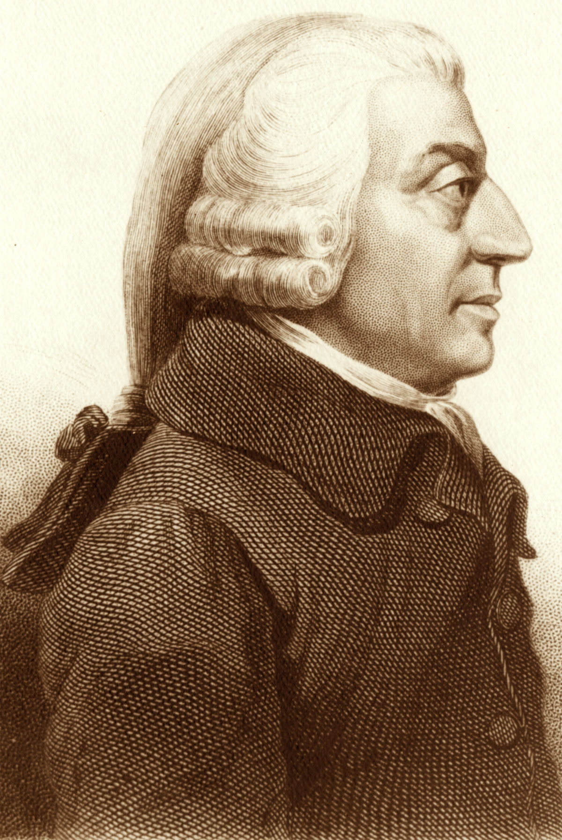
WHO IS THIS BLOKE?
WHAT DO YOU KNOW ABOUT HIM?

Slide 17
LEARNING OBJECTIVES
Lo1: State what is meant by specialisation and the division of labour.
Lo2: Explain the reasoning behind such methods.
Lo3: Evaluate the effectiveness of these methods.

Slide 18
Specialisation and Division of Labour*
We shall start by answering the first questions as a class and then use this knowledge to complete the rest individually.

Slide 19
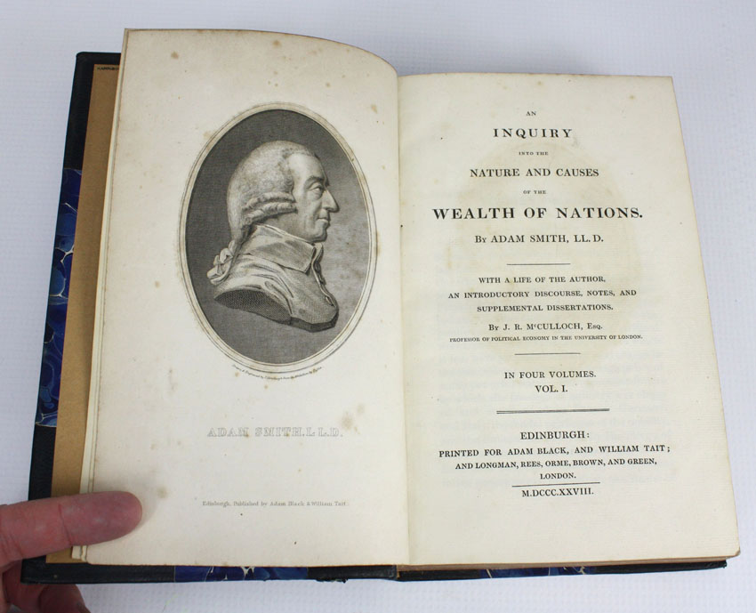
ADAM SMITH…
What do you know about Adam Smith?
The Wealth of Nations (1776)
The founding father of modern economics.
We learn more about Adam Smith later on in Theme 1.

Slide 20
ADAM SMITH’S PIN FACTORY
As mentioned in The Wealth of Nations, Adam Smith (1723-1790) had a pin factory.
10 workers could individually produce 20 each a day, so 200 pins in total per day.
However, Adam Smith theorised that by dividing up the labour… they could produce more.
He was right. By separating production into 10 stages, each worker become more specialised.
Resulting in output increasing to 48,000 per day!
Note: Smith didn’t invent this theory – he applied/popularised.

Slide 21
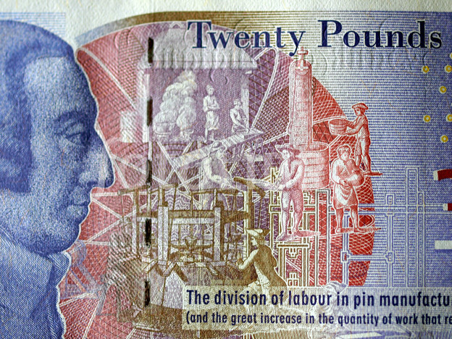

Slide 22
The Wealth of Nations…
“A workman not educated to this business could scarcely make one pin in a day, and certainly could not make twenty. But in the way in which this business is now carried on… it is divided into a number of branches… one man draws out the wire, another straightens it, a third cuts it, a fourth points, a fifth grinds it at the top; to make the pin head requires two or three distinct operations; to put it on is a peculiar business, to whiten the pins is another; it is even a trade by itself to put them into the paper. This way ten workers could make perhaps 48,000.”

Slide 23
DIVISION OF LABOUR
Definition: “Process whereby the production procedure is broken down into a sequence of stages, and workers are assigned to a particular stage.”
Concentration increases efficiency. Over time, if you divide production up into sections, each employee increases their productivity (output per worker).
Division of labour is a type of specialisation – in which labour co-operates with each other to produce one good.

Slide 24
FORD – MODEL T
The world’s first and affordable car was the Ford Model T.
Henry Ford was able to make this automobile affordable as it was the first to be mass produced.
First built in 1908, Henry Ford exploited division of labour to reduce costs and time.
Watch the video clip and consider any advantages and disadvantages of the division of labour production method.
https://www.youtube.com/watch?feature=player_embedded&v=S4KrIMZpwCY

Slide 25
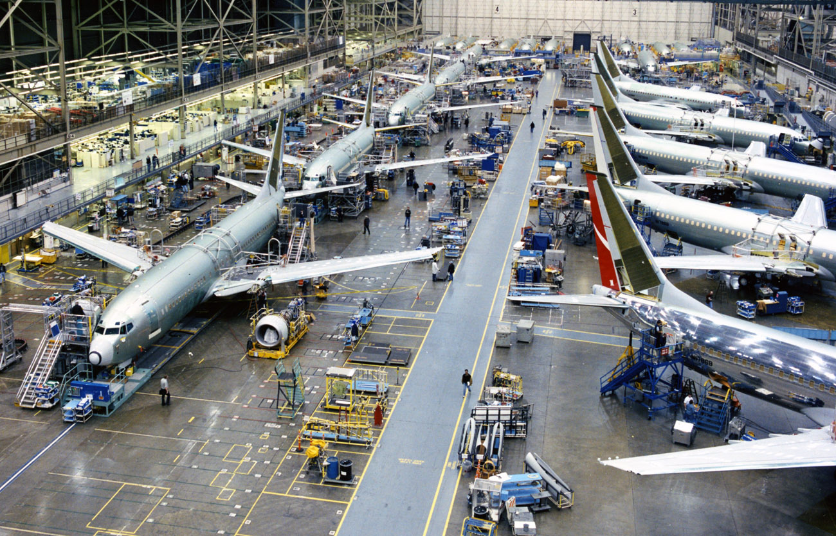

Slide 26
SPECIALISATION and DIVISION OF LABOUR*
Complete the rest of the worksheet.
Complete the statements using the phrases provided.
Using the notes and the discussions we have had… outline the advantages and disadvantages of specialisation.

Slide 27
SPECIALISATION QUIZ SHEET…
A worker who completes a portion of a good or service is a..? specialist
The calculation for productivity is output divided by..? Number of workers
A worker who completes all steps in the production of a good or service is a..? craftsperson
A business purchase of new machinery and equipment is an..? investment in capital resources
The process where workers perform only a single or very few steps of a major production task is..? division of labour
Kendrick School sends its employees for computer training. This is an example of..? investment in human capital
Increasing productivity results in..? more goods being produced using less inputs
An advantage of the craftsperson method of production would be..? variety during the workday
Increases in productivity generally result in..? lower prices for consumers

Slide 28
DRAWBACKS OF DIVISION OF LABOUR
Limited by the size of the market – mass production of Porches? Niche products. Anything custom made.
Large scale specialisation – is it possible?
Mass production – not such a great thing, lacks character.
Some products cannot be mass produced – travel, fancy meals
Monotonous jobs – low morale, boredom.
Workers have a narrow skillset, so could be a problem if they lose their job.
If one machine breaks/employees sick, then whole production could well stop.

Slide 29
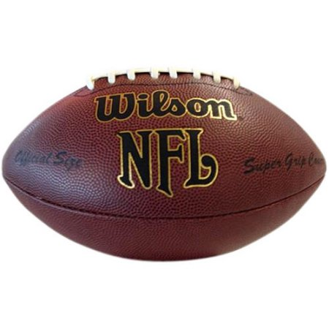
http://www.youtube.com/watch?v=PkCwsKGO-2o (5:07)

Slide 32
Animation Questions*
Watch this animation and answer the following on your sheets…
What were the disadvantages of each household producing everything for themselves?
What is a subsistence economy?
How did they solve the problem of working all day and all night?
Why did they choose this solution?
What resulted from this?
http://www.youtube.com/watch?v=DunKKFsvXig (9:04)

Slide 34
TRADE and SPECIALISATION

Slide 35
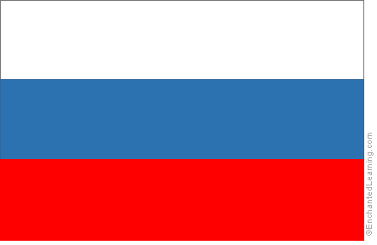
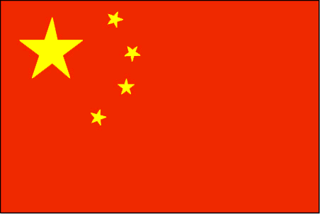
Coffee, Bacon, Tea, Oil, Bananas, Electricals, Financial Services, Non-knit coats, Chocolate, Vodka
Also, consider why you think they produce large quantities of this good/service?
Notes:
Switzerland – Chocolate Denmark - Bacon
Brazil – coffee/nuts. Russia - Vodka
UK – Financial services China – Electricals/manufactured goods
Ecuador – Bananas India- Tea

Slide 36
TRADE and SPECIALISATION
We have only explored specialisation on a small scale.
But specialisation can also occur on a global scale between nations.
Using the concept of opportunity cost in your answer, explain why India produces bananas and the United Kingdom does not.

Slide 37
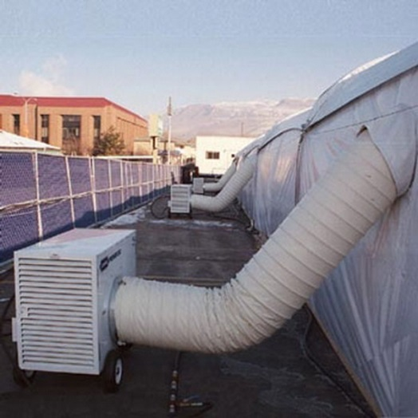
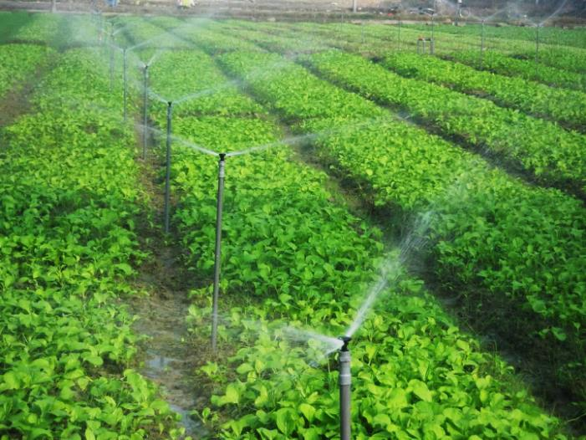
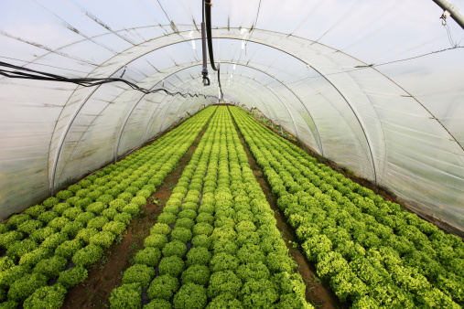
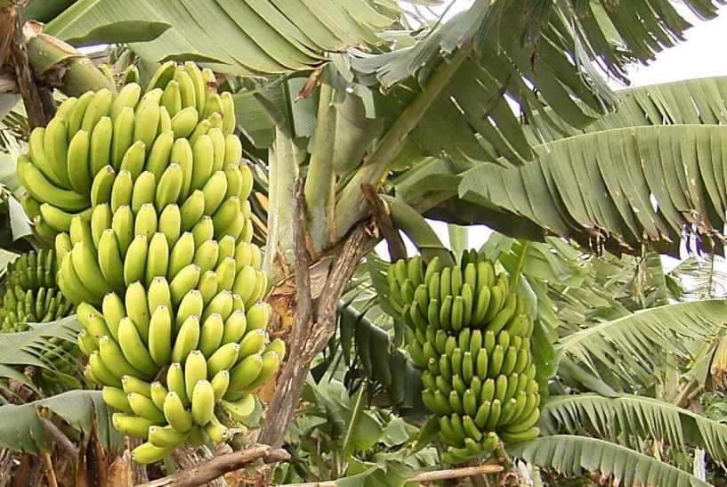
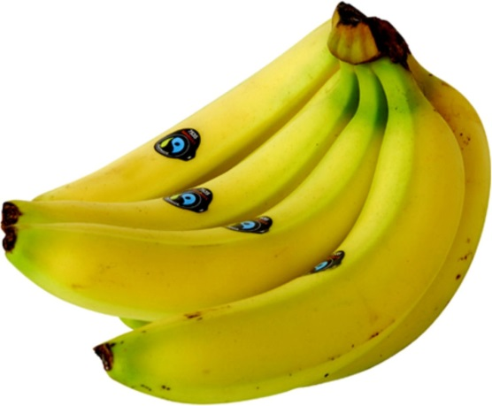
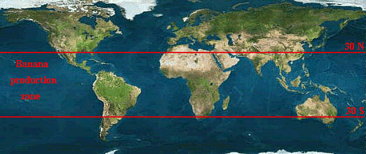
Why do we trade?
However the UK is colder and has less rainfall than India - therefore the opportunity costs of producing bananas is higher, as resources have to be taken from other areas of the economy to create the correct growing conditions.
So it is cheaper to import/trade.
Electricity
Water
Climate Control Systems
India specialises in banana production (20% of overall global production) as it is endowed with the inputs required to produce them. So the opportunity cost is lower
Notes:
Take bananas for example; India is the world’s largest banana producer with 20% of overall production. India has a comparative advantage when it comes to bananas, because they are endowed with the inputs required to produce bananas – namely a hot climate and plenty of rain. The opportunity cost of producing bananas would be much higher in the UK; as a result of the cooler climate and less rainfall, resources would have to be used (which could be utilised elsewhere – opportunity cost) to create the necessary conditions for growing bananas – ie. Large temperature controlled warehouses and watering facilities. The UK does however possess a comparative advantage when it comes to pharmaceuticals and financial services, because we are endowed with highly skilled labour and world class institutions for producing these goods/services.

Slide 38
SPECIALISATION & TRADE
Successful economies that engage in specialisation are able to produce more than they need for survival (no longer subsistence).
These surpluses can be traded with other economies.
Other economies can produce goods at a lower opportunity cost, therefore (globally) resources are used more efficiently.
Trading means that overall prosperity increases.
Trade means that individual economies no longer need to attempt to produce everything that it requires.

Slide 39
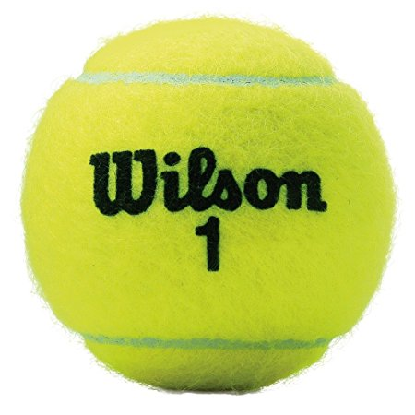
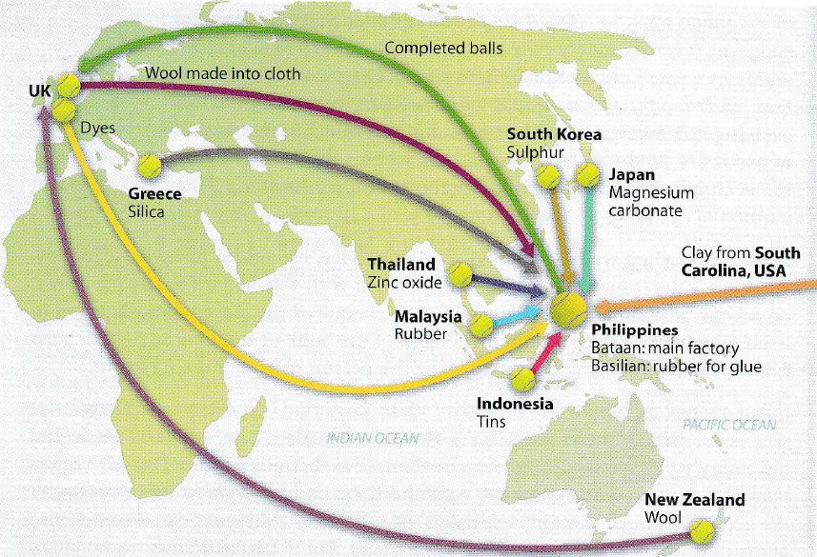
TRADE – CASE STUDY*

Slide 40
With reference to Extract 1, assess the likely benefits of the division of labour in the production of wind turbines. (10)

Slide 42
GROUP TASK!
http://www.classtools.net/education-games-php/timer
In groups of 4 – you’ll have 3 1/2 minutes to produce as many coloured squares as you can. Each square must be:
6cm x 6cm
Completely coloured in
Have your team name written on a piece of paper and stuck in the centre.
Team that produces the most, Wins a prize!
Paper must be cut individually, not placed on top of each other!
Every faulty product will be deducted from your final total!
6cm x 6cm

