Slide 1
Edexcel A2 Business
3.3.2 Investment appraisal
Revisionstation

Slide 2
Worksheet

Slide 3
Calculators will be needed for this topic

Slide 4
From Edexcel
a) Simple payback
b) Average (Accounting) Rate of Return (ARR)
c) Discounted Cash Flow (Net Present Value only) (NPV)
d) Calculations and interpretations of figures generated by these techniques
e) Limitations of these techniques

Slide 5
Starter
You own a business. You have a meeting with your Marketing Director, your Production Manager and your Research Team Manager, They know you have £1million retained profit which can only be spent on one project. They each pitch their idea to you, which do you choose:
Project 1: A New warehouse which will mean you can double your capacity
Project 2: A new marketing campaign which will double sales
Project 3: Research into new products which will give you an edge in a highly competitive technical market place
Notes:
Should lead to a discussion where the students work out that without some numbers behind the projects in terms of costs and projected returns they cannot be compared or chosen between – a good time to introduce investment appraisal.

Slide 6
Investment appraisal defined
Investment appraisal attempts to determine the value of capital expenditure projects. It enables the business and its investors to compare projects so that the business can expand and meet their objectives – usually profit maximisation and efficiency.

Slide 7
Investment appraisal – planning process
Investment appraisal is the planning process used to determine whether the long term investments will give the best return.
Projects such as;
new machinery
new premises
research and development projects

Slide 8
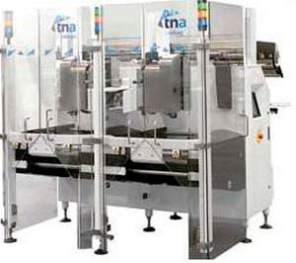
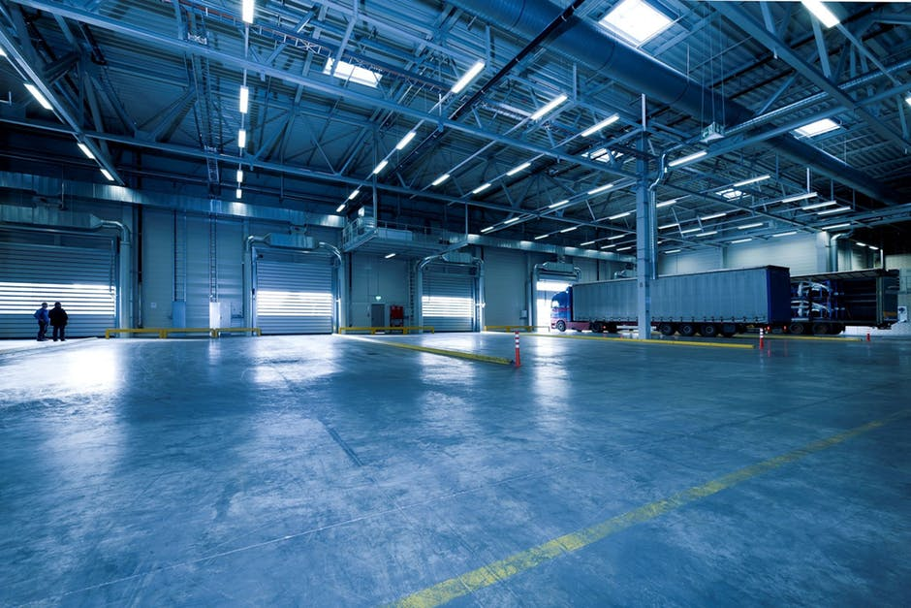
Investment appraisal – decision making
Proposal 2: new machinery
Proposal 1: new premises
Proposal 3: Research
A business will have lots of ideas for projects, and proposals of ways to grow their business. The business will only have a finite amount of money and so perhaps only one project will get the funding it needs to go ahead. Investment appraisal is used to work out which project should get the funds.

Slide 9
Simple Payback

Slide 10
Payback - explained
A business needs to decide which project or proposal to invest in.
It cannot afford all four so it will have a number of methods to work out which one it should spend the money on.
The table starts at year 0 because this is the amount invested in the project at the start
For example, proposal 1 will cost £120,000
Cash flows (£000s) | Proposal 1 | Proposal 2 | Proposal 3 | Proposal 4
Year 0 | -£120 | -£95 | -£80 | -£160
Year 1 | £80 | £10 | £30 | £30
Year 2 | £60 | £40 | £40 | £50
Year 3 | £40 | £40 | £30 | £90
Year 4 | £20 | £60 | £30 | £80
Year 5 | £40 | £50 | £20 | £60

Slide 11
Very simple Payback calculation
Lets look at proposal 1
Year 0 is the investment so it will cost £120,000 to get the project going
When will this be paid back?
In year 2 the project made £80,000 from year one plus £40,000 from year 2.
The project pays back in year 2
Cash flows (£000s) | Proposal 1 | Proposal 2 | Proposal 3 | Proposal 4
Year 0 | -£120 | -£95 | -£80 | -£160
Year 1 | £80 | £10 | £30 | £30
Year 2 | £40 | £40 | £40 | £50
Year 3 | £40 | £40 | £30 | £90
Year 4 | £20 | £60 | £30 | £80
Year 5 | £40 | £50 | £20 | £60
Obviously this is too simple – so next slide find out what happens when its part way through a year

Slide 12
Payback calculation
Lets look at proposal 2
Its going to cost the business £95,000 to get this project up and running
Year 1 the project makes £10,000
Year 2 the project makes £40,000
Year 3 the project makes £40,000
So far it has paid back £90,000
Now we need £5,000 more from year 4 so:
Cash flows (£000s) | Proposal 1 | Proposal 2 | Proposal 3 | Proposal 4
Year 0 | -£120 | -£95 | -£80 | -£160
Year 1 | £80 | £10 | £30 | £30
Year 2 | £40 | £40 | £40 | £50
Year 3 | £40 | £40 | £30 | £90
Year 4 | £20 | £60 | £30 | £80
Year 5 | £40 | £50 | £20 | £60
Final answer is proposal 2 will payback in 3 years and 1 month
5,000
Round this up to one month
_______
X 12
=
0.9
60,000

Slide 13
Calculate the payback periods
Cash inflows (£000s) | Proposal 1 | Proposal 2 | Proposal 3 | Proposal 4
Year 0 | -£120 | -£95 | -£80 | -£160
Year 1 | £80 | £10 | £30 | £30
Year 2 | £40 | £40 | £40 | £50
Year 3 | £40 | £40 | £30 | £90
Year 4 | £20 | £60 | £30 | £80
Year 5 | £40 | £50 | £20 | £60
When does the project payback?

Slide 14
Calculate the payback periods
Cash inflows (£000s) | Proposal 1 | Proposal 2 | Proposal 3 | Proposal 4
Year 0 | -£120 | -£95 | -£80 | -£160
Year 1 | £80 | £10 | £30 | £30
Year 2 | £40 | £40 | £40 | £50
Year 3 | £40 | £40 | £30 | £90
Year 4 | £20 | £60 | £30 | £80
Year 5 | £40 | £50 | £20 | £60
When does the project payback?

Slide 15
ARR

Slide 16
ARR explained
Payback is very simplistic tool and only looks at when the project will pay back and does not take into account rate of return
So a business can also use the ARR system which looks at the average rate of return of the projects

Slide 17
ARR calculation
Lets look at proposal 3
Add up all the cash inflows from years 1-5 = £150,000
Then minus the original cost of the project = £70,000
Then divide this by the number of years the project runs for :
Now take this figure and divide it by the cost of the project:
Cash Inflows (£000s) | Proposal 1 | Proposal 2 | Proposal 3 | Proposal 4
Year 0 | -£120 | -£95 | -£80 | -£160
Year 1 | £80 | £10 | £30 | £30
Year 2 | £40 | £40 | £40 | £50
Year 3 | £40 | £40 | £30 | £90
Year 4 | £20 | £60 | £30 | £80
Year 5 | £40 | £50 | £20 | £60
70,000
_______
=
14,000
5
Need to compare this % with the other proposals to see which would give the highest average rate of return
14,000
_______
X 100
=
17.5%
80,000

Slide 18
Calculate ARR
Cash Inflows (£000s) | Proposal 1 | Proposal 2 | Proposal 3 | Proposal 4
Year 0 | -£120 | -£95 | -£80 | -£160
Year 1 | £80 | £10 | £30 | £30
Year 2 | £40 | £40 | £40 | £50
Year 3 | £40 | £40 | £30 | £90
Year 4 | £20 | £60 | £30 | £80
Year 5 | £40 | £50 | £20 | £60
ARR

Slide 19
Calculate ARR
Cash Inflows (£000s) | Proposal 1 | Proposal 2 | Proposal 3 | Proposal 4
Year 0 | -£120 | -£95 | -£80 | -£160
Year 1 | £80 | £10 | £30 | £30
Year 2 | £40 | £40 | £40 | £50
Year 3 | £40 | £40 | £30 | £90
Year 4 | £20 | £60 | £30 | £80
Year 5 | £40 | £50 | £20 | £60
ARR
Your business will want the highest rate of return so proposal 2 would be the one that gets the green light for the funding

Slide 20
NPV

Slide 21
NPV
Once a business has looked at the payback period for a set of projects and then looked at the ARR they may need to look at the NPV
This is the net present value and it takes into account that money in the future is not worth what it is today – so it adds in a discount table to make it more realistic
Money is not worth the same in the future as it is now e.g. what is the cost of a new home today?

Slide 22
NPV calculation
Cash inflows (£000s) | Proposal 1 | Discount table 20% | Present value
Year 0 | -£120 | 1.00 | -£120
Year 1 | £80 | 0.80 | £64,000
Year 2 | £40 | 0.64 | £25,600
Year 3 | £40 | 0.51 | £20,400
Year 4 | £20 | 0.41 | £8,200
Year 5 | £40 | 0.33 | £13,200
Total |  |  | £11,400
Lets look at proposal 1
First take a discount table, in this example it is a 20% discount each year, to make the profit figure more realistic as money in the future is worth less than it is now
Multiply each cash inflow by the discount, this gives the present value column
NPV is all the NPV values added together then minus the initial cost
In this example the NPV is £11,400
You will be given the discount table in the exam– you do not have to memorise these figures

Slide 23
Calculate the NPV
Cash Inflows (£000s) |  | Proposal 1 | Proposal 2 | Proposal 3 | Proposal 4
Year 0 | 1 | -£120 | -£95 | -£80 | -£160
Year 1 | 0.833 | £80 | £10 | £30 | £30
Year 2 | 0.694 | £40 | £40 | £40 | £50
Year 3 | 0.579 | £40 | £40 | £30 | £90
Year 4 | 0.482 | £20 | £60 | £30 | £80
Year 5 | 0.402 | £40 | £50 | £20 | £60
NPV value

Slide 24
Interpretations

Slide 25
Interpretations
Payback period – is the time period for the original financial investment cost of a project to be fully recovered
This is the length of time that the money invested is at risk

Slide 26
Limitations

Slide 27
Limitations of Investment Appraisal
Payback limitations; very simple, only looks at speed of payback and dopes not look at profitability
ARR limitations; Does not take into account the effects of time on the value of money
NPV limitations; Very complex, not used by small business, also results dependent on rate of discount used, the higher the rate the more likely it is that the project will be rejected as unprofitable

Slide 28
Revision video 1

Slide 29
Revision Video 2

Slide 30
Sample Edexcel A2 questions

Slide 31
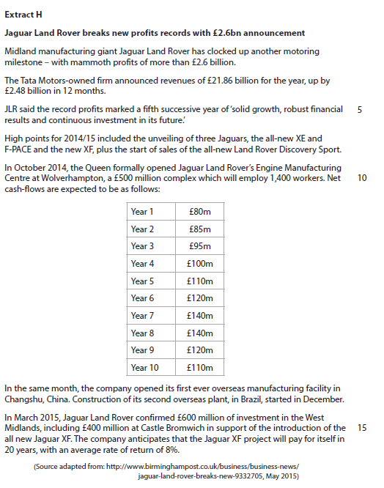
Case study for question 1

Slide 32
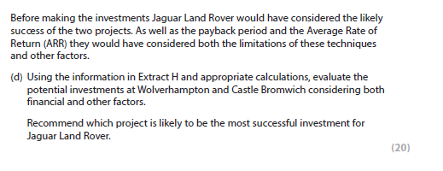
Sample question 1
Knowledge 4
Application 4
Analysis
6
Evaluation
6

Slide 33
Case study for question 2

Slide 34
Glossary
ARR; Average rate of return, a simple method of calculating which project offers the best rate of return on an investment, compare with bank rate of 5% for savings
NPV; Pet present value, discounts the future value of money, taking into account interest rates and time
Payback; simple method of working out which project proposal will pay the investors back the soonest

