Slide 1
Devising Final Piece.
LO: To use a different approach to devised work.

Slide 2
Learning Outcomes.
By the end of the lesson you should be able to…
Recall the four basic dramatic strategies used.
Describe how you used the drama medium appropriately.
Explain why the elements of drama effect your dramatic intentions.

Slide 3
What you are doing.
At the end I said to the TV interviewer
One day as we walk in the street
We will see the state of the world and how we live
And burst into tears
And change it
When it was screened they cut out
And changed it
And ended with tears
Next time I will cut the tears

Slide 4
Starter
On the clipboard there is a sheet.
5 minutes to complete the questions on the sheet.
By yourself…………in silence.

Slide 5
Progress Check
Get into your groups….
Share your ideas with your group and on the back of your sheet write a brief plot of what this play could be about.

Slide 6
In Your Groups
I am going to show you a photograph.
Take a minute just to look at the photograph.
Answer the questions on your sheets labelled…
Photograph

Slide 7
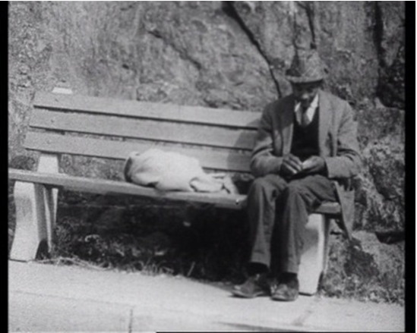

Slide 8
Progress Check
Share your ideas with other groups…
Do they have a clear dramatic aim or intention for the audience?
What is the purpose.

Slide 9
In groups
In your groups using the ideas that you now have and using the final poem. Create a short performance that has a clear audience intention.
Remember:

Slide 10
Success Criteria
Have a message/intention/ aim for you audience.
No longer than 1 minute.
Must use some of the words from the poem.
Must have one dramatic technique.

Slide 11
Theory Work (written paper)
Explorative Strategies.
Role Play.
Story telling.
Other technique you have used.
Photographs/set/poem as stimulus.
Drama Medium.
Use of Voice.
Use of spoken language.
Use of movement and gesture.
Elements of Drama.
Characterisation.
Creating Storylines.

Slide 12
Independent Learning.
To construct a portfolio charting your process of production.
4 sections Use the sheet to help you.
Deadlines
1st:18th February
2nd: 25th February
3rd:4th March
4th: 18th March
Final Copy: 12th April

