Slide 1
Draw the two diagrams to represent:
Subsidy
Indirect Tax
Identify the consumer and producer burden on both.
RECAP: What is PED?

Slide 2
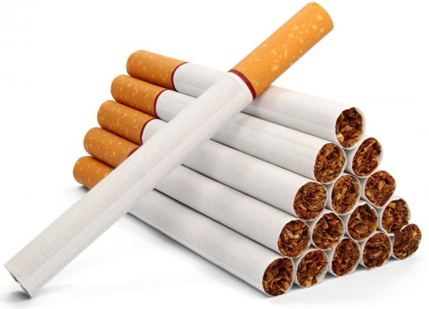
TASK…
List all of the dangers and problems associated with smoking.
Try to think of at least five!

Slide 3
STARTER
Assess the economic benefits of the Chancellor's policies in the 2017 Budget.
KAA – Outline and explain actual benefit
EV – Critique that benefit… unintended consequences? Long-term/short-term? Is everybody effected the same? Scale of impact(s).

Slide 4
LEARNING OBJECTIVES
Lo1: Define what an externality is.
Lo2: Draw diagrams to represent the two types of externalities.
Lo3: Analyse diagrams to represent welfare loss and apply to real-life scenarios.

Slide 5
Specification
Negative production
Positive consumption
Only two diagrams mentioned in new specification.
Other externality diagrams do exist, but do not need to be learnt.
1.3.2 Externalities
a) Distinction between private costs, external costs and social costs
b) Distinction between private benefits, external benefits and social benefits
c) Use of a diagram to illustrate:
the external costs of production using marginal analysis
the distinction between market equilibrium and social optimum position
identification of welfare loss area
d) Use of a diagram to illustrate:
the external benefits of consumption using marginal analysis
the distinction between market equilibrium and social optimum position
identification of welfare gain area
e) The impact on economic agents of externalities and government intervention in various markets.

Slide 6
In pairs… Using the list of dangers of smoking, split them into 2 categories. You decide the two categories.
Passive smoking, Extra NHS expenditure (which comes from taxes)
Cigarette breaks (reduced productivity)
Numerous health problems,
Days off work
Poor everyday health (shortness of breath)

Slide 7
In pairs… Using the list of dangers of smoking, split them into 2 categories. You decide the two categories.
A social cost is a cost experienced by third parties as a result of consumption of a product or service by another individual.
A private cost is a cost that is experienced by the individual/firm that has consumed the product or service.

Slide 8
THE BASICS…
A private cost is a cost that is experienced by the individual/firm that has produced the product or service. Including material costs or health problems.
A social cost is a cost experienced by third parties as a result of consumption of a product or service by another individual. (Private cost + externality) e.g. cost to produce car (private cost) + pollution cost to society.

Slide 9
When the CONSUMPTION or PRODUCTION of a product or service has an EXTERNAL impact on a THIRD party we call this an EXTERNALITY.
The term ‘externalities’ refers to the spill over EFFECTS upon the third parties.

Slide 10
https://www.youtube.com/watch?v=AkSXB-lRAp0
Notes:
https://www.youtube.com/watch?v=AkSXB-lRAp0 24:00
https://www.youtube.com/watch?v=XzvKgxrlQ84&utm_source=Facebook&utm_medium=Seeding&utm_campaign=Indonesia%20Short

Slide 11
CITARUM RIVER…
What are the third part costs (social costs) being experienced?
What are the private costs being experienced by the textile firms?
How have the Indonesian government tried to combat the problems and is it working?
Are there any third party benefits (social benefits) being experienced?

Slide 12
THE BASICS…
A private cost is a cost that is experienced by the individual/firm that has produced the product or service. Including material costs or health problems.
A social cost is a cost experienced by third parties as a result of consumption of a product or service by another individual. (Private cost + externality) e.g. cost to produce car (private cost) + pollution cost to society.

Slide 13
M = Marginal
This means for each additional unit.
Qe = current mark equilibrium
Qe = Market generated level of output. MPC (Supply) = MPB (Demand)
Cost/Benefit
MSC
Q* = Socially optimal level of output.
MPC
Market failure because the market gives us Qe which is higher than the optimal.
At the free-market (Qe) equilibrium, MSC is greater than MPC. The difference is the externality.
NEGATIVE EXTERNALITY OF PRODUCTION
MSB = MPB
Producing more than Optimal Quantity
Citarum River has had toxic waste dumped into it by textiles plants.
Q*
Qe
Quantity
Notes:
Ask students to draw externalities diagram. - Is it production/consumption? - Merit or demerit?
MSC = Private costs + External costs Private costs (MPC) are costs to factory owners, like rent, wages and raw materials. Externality is the third party cost to society.
The total cost to society therefore (MSC), must include the private cost because society’s resources are being used in the production process, as well as the externality, because society’s resources are being used to clear up the mess (pollution).
MPC represents the factory’s supply curve (this is also its marginal cost curve). MSC represents the true supply curve (therefore, true marginal cost curve) for society as a whole, which takes into account the external costs to society.
**Demand curves do effectively measure the private/social benefit (here they are equal, as we’re assuming no externalities from consumption) of consuming a certain good. Ie. If 100 Mars Bars are sold at 30p, then one assumes that those 100 people felt that a Mars Bar would give them 30p of benefit.
Intervention places an additional cost upon the factory, which moves the MPC to the left. This extra cost doesn’t place any extra burden upon society, therefore MSC remains in the same position and so the welfare loss triangle becomes smaller.

Slide 14
https://www.youtube.com/watch?v=EDN2MBU92vo
Portsmouth Professor – 6:18 – Negative externality of production.

Slide 15
HOLD ON THOUGH!
Externalities do not have to be negative!
Society can benefit positively from both the production and consumption of goods/services.
We call these… POSITIVE EXTERNALITIES.
The following diagram is for…
Positive externalities of consumption.

Slide 16
THE BASICS…
A private benefit is a benefit that is experienced by the individual that has consumed the product or service.
A social benefit is a benefit experienced by third parties as a result of consumption of a product or service by another individual. (Private benefit + externality) e.g. gaining an education (private benefit) + reduced crime

Slide 17
There are no negative externalities in this diagram (for simplicity) so MSC = MPC
Q* = Socially optimal level of output. Best level for society.
Cost/Benefit
MSC = MPC
Qe = Free market. At this quantity, the MSB is greater than the MPB. The difference is the positive externality.
You’re probably wondering why there is a welfare loss triangle?
Well… If output was at Q*, extra welfare could be gained.
So by only being at Qe, this represents lost welfare.
MSB
POSITIVE EXTERNALITY OF CONSUMPTION
MPB
Consuming less than Optimal Quantity
A young child is taken by their parent to have a Polio and Smallpox vaccination.
Qe
Q*
Quantity
Notes:
Things like healthcare and education provide positive externalities to third parties.
However, when left to the market, we won’t get enough of these goods (market failure). As market forces will only generate so much, as a larger level of output would be good for society.
Private benefits = those enjoyed by the buyers and sellers.
Marginal private benefit = the extra benefit enjoyed by having one more. MPC = cost of one more.
MSB = The private benefit + the externality which, in this case, is positive.
Education: If you’re in education, you’re earning more and pay more tax – which is then spent on society and benefits them.
Healthcare: Vaccination for the private benefits of avoiding flu. Benefits society as they’re now less likely to get sick.

Slide 18
TWO TYPES OF EXTERNALITIES
Marginal Social Benefit is greater than Marginal Private Benefit (MSB>MPB)
Positive externality of consumption =
Negative externality of production =
Marginal Social Cost is greater than Marginal Private Cost (MSC>MPC)

Slide 19
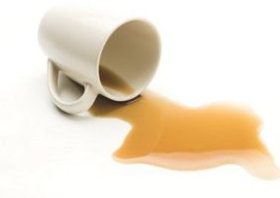
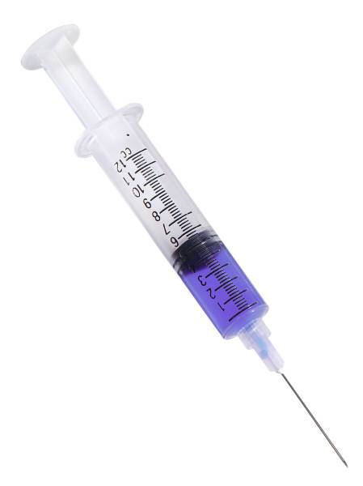
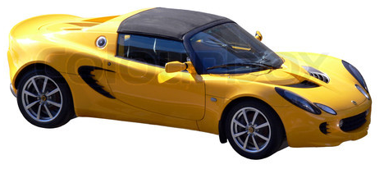
WHAT IS AN EXTERNALITY?
Third party (or spill over) effects of production, where no appropriate compensation is paid.
Negative externalities are over-produced and over-consumed – also referred to as demerit goods.
Positive externalities are under-produced and under-consumed - also referred to as merit goods.

Slide 20
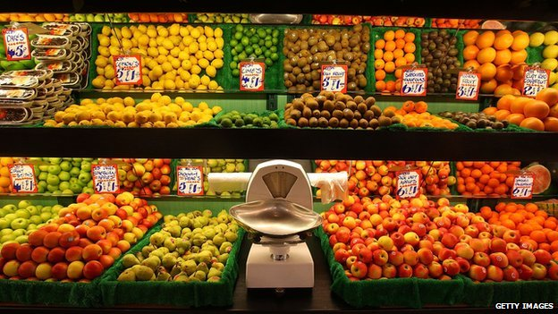
EVALUATION: WHAT IS Q*?
Read the article relating to a discussion regarding ‘seven-a-day’.
This illustrates a strong evaluative point when it comes to discussing externalities during exams.
What do you think that point is?

Slide 21
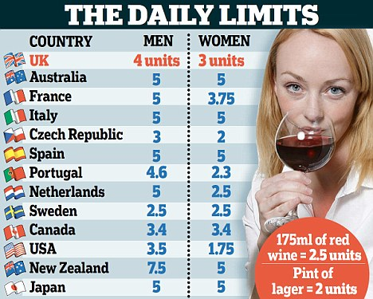
The table below demonstrates the uncertainty surrounding the ‘socially optimum’ level of quantity.
EXCELLENT EVALUATION:
If Q* is not known precisely, then we also do not know precisely how large the externality is.
Furthermore, the government does not know how much is needs to intervene in order to solve the problem.

Slide 22
REDUCING THE WELFARE LOSS
In order to increase the quantity (positive externality) or reduce the quantity (negative externality).
Treat MPB as a demand curve and MPC as a supply curve.
Example: Subsidy and tax would shift MPC (supply) left/right.
Example: Government information would shift MPB (demand) left/right.
The demand curve represents marginal benefit, it shows the amount consumers are willing to pay. Willingness to pay reflects the benefit derived from each unit.
MPC (Supply)
MPC is the cost of producing an additional unit of a good/service, it is paid by the producer. The marginal private cost curve is equivalent to the firm's supply curve.
MPB (Demand)

Slide 23
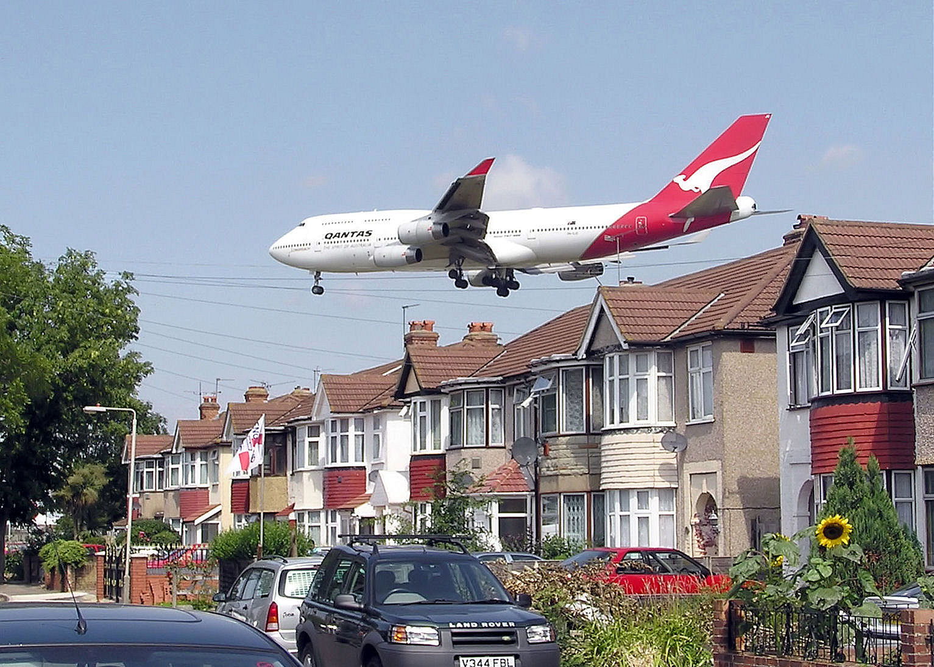
What are the externalities in this photo?

Slide 24
Qe = current mark equilibrium
Qe = Market generated level of output. MPC (Supply) = MPB (Demand)
Cost/Benefit
MSC
MPC2
Q* = Socially optimal level of output.
MPC
Market failure because the market gives us Qe which is higher than the optimal.
Taxation shifts MPC (supply) to the left, thus reducing the market quantity to Qe2 – there is now a smaller triangle.
NEGATIVE EXTERNALITY OF PRODUCTION
MSB = MPB
How can taxation be used to reduce the welfare loss?
Q*
Qe2
Qe
Quantity
Notes:
Ask students to draw externalities diagram. - Is it production/consumption? - Merit or demerit?
MSC = Private costs + External costs Private costs (MPC) are costs to factory owners, like rent, wages and raw materials. Externality is the third party cost to society.
The total cost to society therefore (MSC), must include the private cost because society’s resources are being used in the production process, as well as the externality, because society’s resources are being used to clear up the mess (pollution).
MPC represents the factory’s supply curve (this is also its marginal cost curve). MSC represents the true supply curve (therefore, true marginal cost curve) for society as a whole, which takes into account the external costs to society.
**Demand curves do effectively measure the private/social benefit (here they are equal, as we’re assuming no externalities from consumption) of consuming a certain good. Ie. If 100 Mars Bars are sold at 30p, then one assumes that those 100 people felt that a Mars Bar would give them 30p of benefit.
Intervention places an additional cost upon the factory, which moves the MPC to the left. This extra cost doesn’t place any extra burden upon society, therefore MSC remains in the same position and so the welfare loss triangle becomes smaller.

Slide 25
THINKING FURTHER CHALLENGE…
If you finish… A* challenge!
Draw a positive and negative externality diagram.
Then adapt this diagram to illustrate some form of government intervention.
The new diagram should show the welfare loss triangle being reduced (but not eliminated).

Slide 26
THINKING FURTHER CHALLENGE…
*(d) Apart from a shift in the production possibility frontier, assess the private and external benefits arising from the consumption of health care. Illustrate your answer with an appropriate diagram. (15)
Notes:
June 2011 9d
http://qualifications.pearson.com/content/dam/pdf/A%20Level/Economics/2013/Exam%20materials/6EC01_01_rms_20110817.pdf

