Slide 1
Edexcel A2 Business
4.3.2 Niche markets
Revisionstation

Slide 2
Worksheet

Slide 3
From Edexcel
Cultural diversity: recognition that groups of people across the globe have different interests and values
b) Features of global niche markets
c) Application and adaptation of the marketing mix (4Ps) to suit global niches

Slide 4
Starter
Which definition of niche is correct?
A niche is a shallow recess, especially one in a wall to display a statue or other ornament
A niche is a comfortable or suitable position in life or employment
A niche is the subset of the market on which a specific product is focused
Notes:
All 3 actually – but the business one is number 3

Slide 5
Niche market defined
A niche market is a small specialised market which caters for a particular product or service. E.g. Harley Davidson motorbikes, Rolex watches.

Slide 6
Cultural diversity

Slide 7
Cultural sensitivity
Having cultural sensitivity, means understanding that people all over the world have different interests and values
For example, Thursday 23rd November 2017 is thanksgiving in the USA and Canada so many businesses will be closed on that day (Fourth Thursday in November so the date changes)

Slide 8
International business communication
Having a sensitivity to cultural diversity in communication is the key to smooth international business
For example a business greeting in Japan would be a bow – with different degrees having different meanings
In Western cultures the more familiar business greeting would be a firm handshake

Slide 9
Cultural differences
The greeting rituals are very important in international business, getting it right can set the tone for the whole negotiation
For example in Brazil it is traditional for business colleagues to kiss when they see each other – can you imagine this in the UK?

Slide 10
Cultural diversity
The phrase 'Cultural Diversity' means a range of different societies or people of different origins, religions and traditions all living and interacting together.
In Britain today there is an estimated 'ethnic minority' population of just over 4 million.

Slide 11
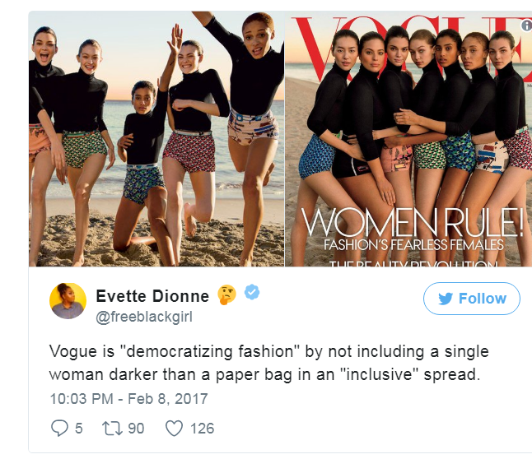
Culture diversity example - discussion
Why are these images of women considered to not be diverse?
Why is diversity in marketing important?
Notes:
Very similar facial features
Need to understand a diverse marketplace or become out of touch with consumers

Slide 13
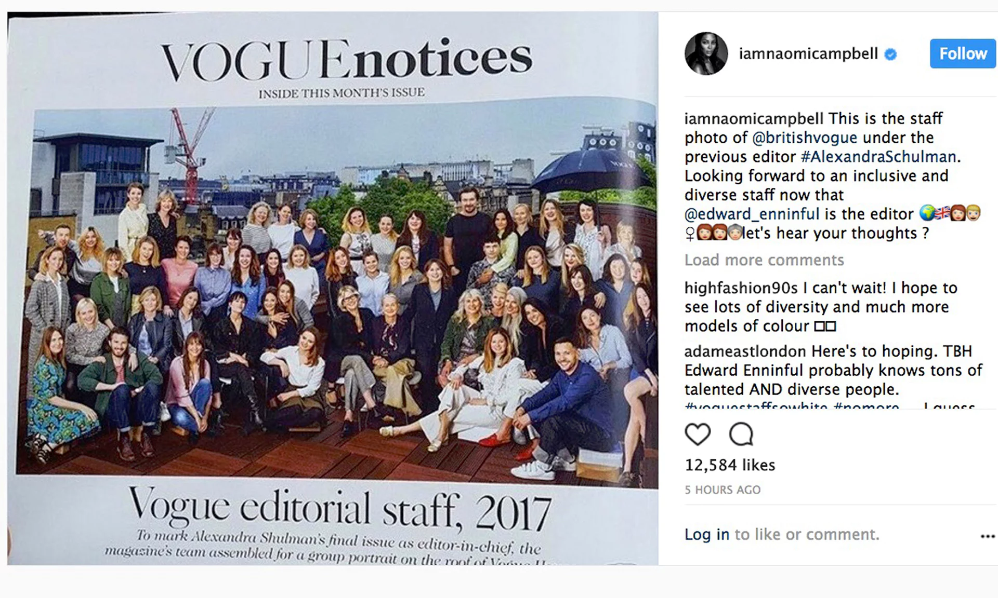
Vogue again
What do you notice about this photo of the Vogue magazine staff?
Notes:
Answer – they are all white

Slide 14
Vogue again
Notes:
Answer – they are all white

Slide 15
Diversity positive example
24, Muslim, Plays for France but is of Guinean decent
White, British
Belgian and a Muslim
Swedish and 35 years old
Argentinian
Argentinian
British, Jamaican decent
Basque
Dutch
Black, British
Armenian
Notes:
Correct at time of writing – my 15 year old football mad son helped me make this slide, so I really hope its correct!

Slide 16
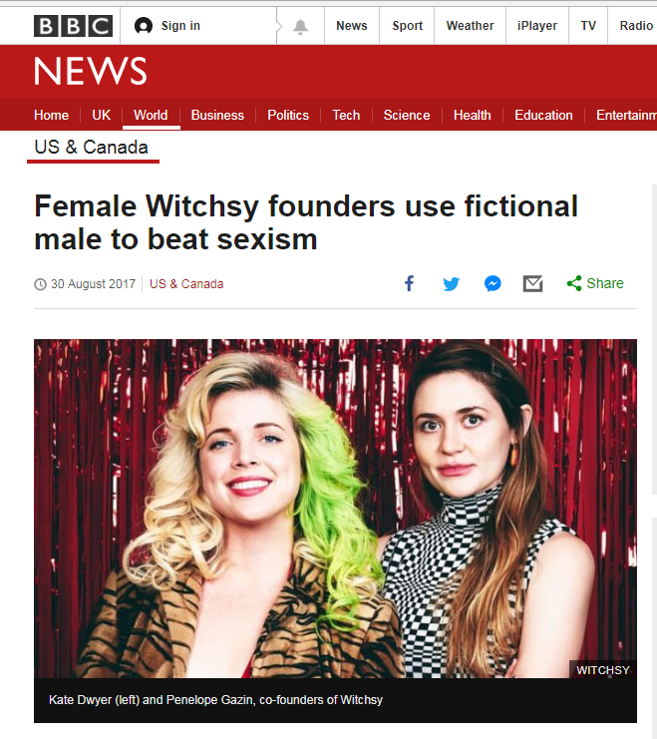
Diversity issues in the workplace
Sexism
Ageism
Discrimination

Slide 17
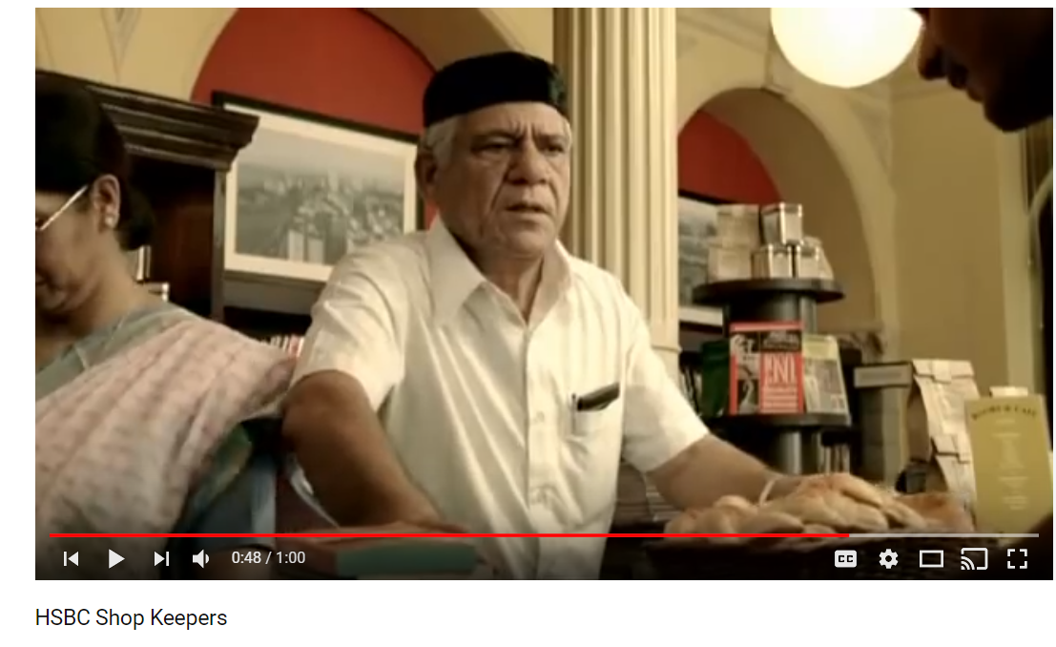
Diversity embraced – marketing example

Slide 18
Features of global marketing

Slide 19
Global niche market defined
A global niche market is a very small market in each country, but the combination of all the countries together make enough demand to make the business profitable
A global market niche is a subset of a global market
A global market niche is highly specialised and is characterised by very loyal customers and premium prices
Niche market is a subset of the mass market

Slide 20
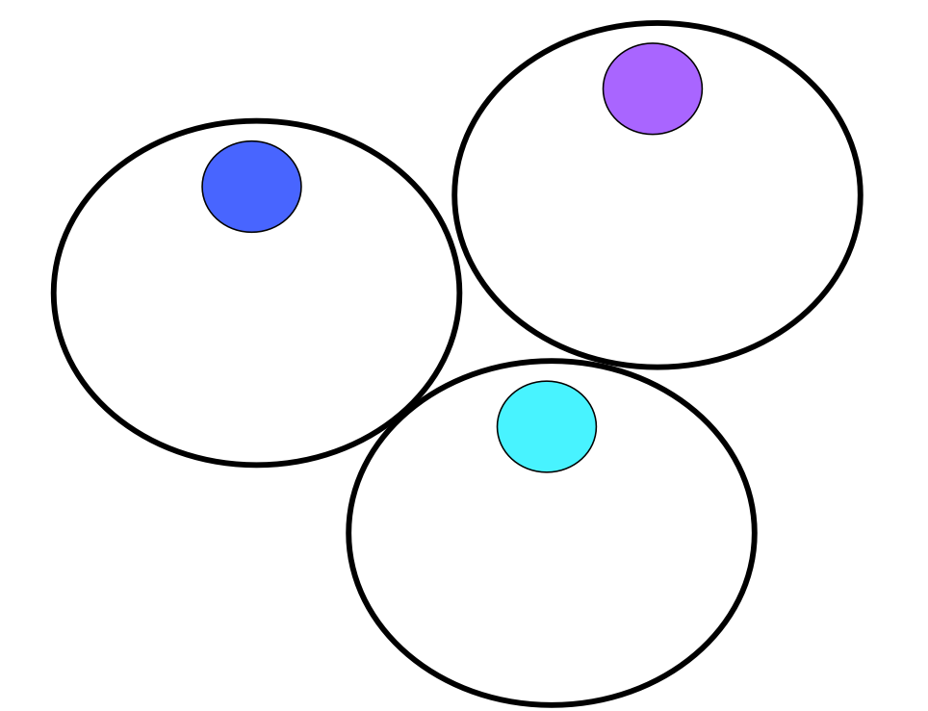
Global niche markets
A niche market in one country can be very small
Niche markets in many countries can build up to a significant market where a business can enjoy high demand

Slide 21
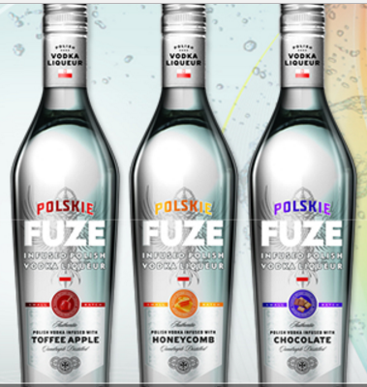
Global niche markets
All businesses have fixed costs, in a niche business the fixed costs are higher
If the business is selling in a niche then why not sell to this niche across the world and reduce the average costs and spread the fixed costs over more units sold
For example Niche Drinks – click the graphic

Slide 22
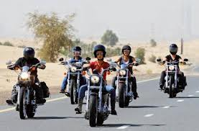
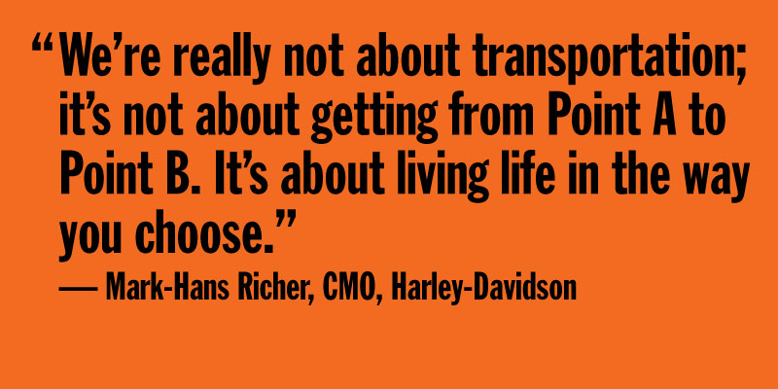
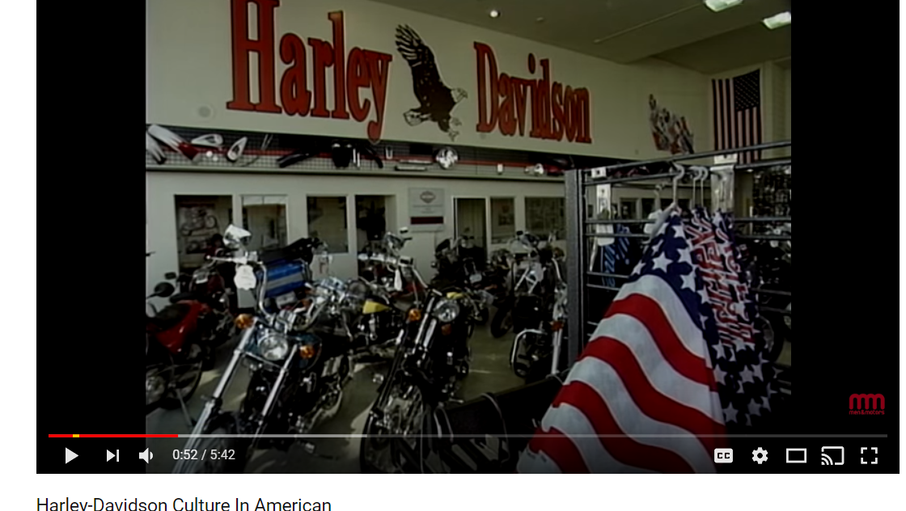
Global niche example Harley Davidson
Harley Davidson Motor Cycles sell a way of life and not just a motorbike
The customers for Harleys are a subculture in that they are united for their love of the product and the lifestyle it projects
The product is made in the USA and 38% of their sales are in International markets
Now over 1million people around the world own a Harley “ bound by the passion to ride”

Slide 23
Selling in a global market niche
Advantages
Disadvantages

Slide 24
Advantages of selling in a global market niche
There is less competition and greater customer loyalty in niche markets.
Prices are likely to be higher and therefore profits may be greater.
Risk may be reduced
Specialist products reduce PED and premium prices may be possible
Global golf market is worth $70 billion
worldwide

Slide 25
Disadvantages of selling in a global market niche
Some of the possible global economies of scale may not be achievable as each market will need individual attention
Co-ordination and communications may be more difficult across differing brands and markets
Some products may require unique ingredients or production techniques reducing the scope for economies of scale

Slide 26
4Ps on cultural niches

Slide 27
Marketing mix in a global niche market
Product
Price
Place
Promotion

Slide 28
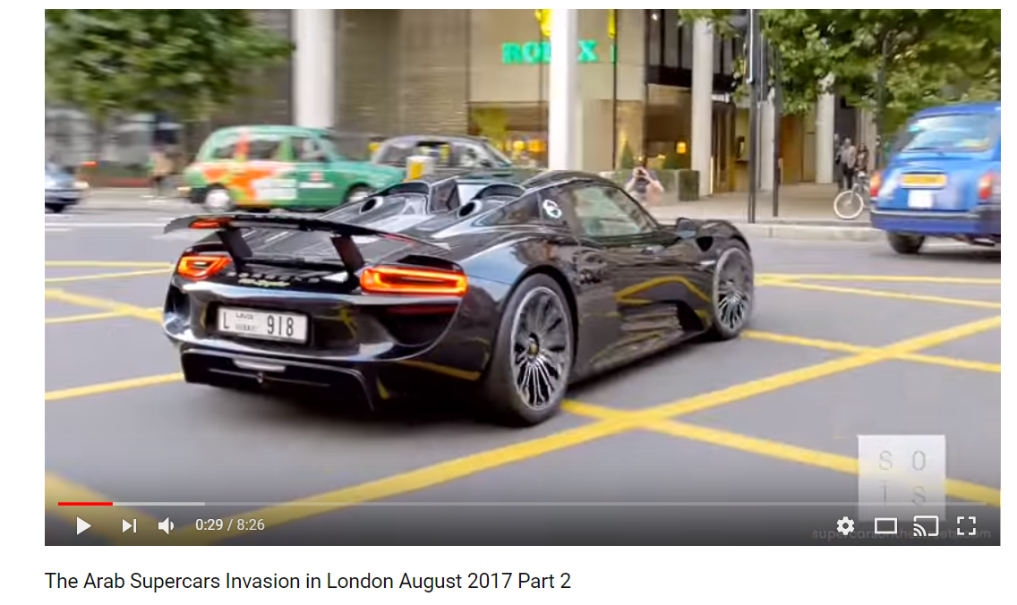
Products in a global niche market
Products that succeed in global markets are usually at the premium end of the market
A prime example is supercars which appeal to only a small subset of a country’s population, but bought by customers in many countries
Every year the streets of London are full of supercars owned by millionaire Arab playboys who pay around £20,000 to have them shipped to the UK for their summer holidays

Slide 29
Pricing strategy in a global niche market
Global niche markets provide an opportunity for businesses to charge premium prices as the products tend to be more unique
It depends on customer perception, as they will pay what they perceive the product to be worth not its actual value in terms of raw materials e.g. Rolex watch or Bugatti car
This is the worlds most expensive dolls house on sale for $8.5 million
Article here with more pictures

Slide 30
Place (distribution) in a global niche market
Niche products can reach a global audience easily thorough websites
Alternatively agents may be used in other countries apart from the host country e.g. Bentley showroom in Dubai which includes a VIP area
The product is made in Crewe in the UK, but sold all over the world to a niche market that can afford the luxury cars

Slide 31
Promotion in a global niche market
Promotion is just the communication aspect of the entire marketing function.
In a global niche market the promotion may be more targeted and subtle than in a mass market
The promotional message must be able to reach across cultures
Brands have to be careful not to devalue the brand image by discounting

Slide 32
Sample Edexcel A2 questions

Slide 33
Case study for question 1

Slide 34
Sample question 1
[6]
Knowledge 2
Application 2
Analysis
3
Evaluation
3
Notes:
6 mark legacy question – no 6 mark questions on the real papers but good practice

Slide 35
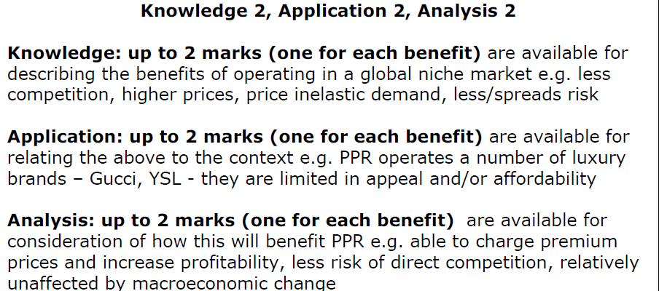
Answer sample question 1

Slide 36
Case study for question 2

Slide 37
Sample question 2
[10]
Knowledge 2
Application 2
Analysis
3
Evaluation
3

Slide 38
Answer sample question 2
e.g. L’Oreal produces different products for different markets
e.g. Lancôme for car driver, Maybelline for bike rider
e.g. each market segment has special requirements, the more precisely that L’Oreal can target that market the more likely they are to sell. Specialist products reduce PED and premium prices may be possible, customer loyalty is increased and further products may be launched on their back
e.g. Soft Sheen and Carson. A variety of markets spreads risk. e.g. there are some drawbacks, some of the possible global economies of scale may not be achievable as each market will need individual attention. Perhaps contrasted with the benefits of a true global marketing strategy. Co-ordination and communications may be more difficult across differing brands and markets.
e.g. Some products may require unique ingredients or production techniques reducing the scope for economies of scale. Some brands are global but others will be specific to geographical or ethnic segments and require their own marketing and promotion

Slide 39
Glossary
Cultural diversity; Means a range of different societies or people of different origins, religions and traditions all living and interacting together.
Global niche; A market which is a subset of a global market, for example Harley Davidson riders
Ansoff’s Matrix; The Ansoff matrix is another marketing planning tool that helps a business determine its product and market growth strategy. Ansoff's product/market matrix suggests that a business' attempts to grow depend on whether it markets new or existing products in new or existing markets.
Marketing mix; The method of using the 4Ps of marketing to get the right product to the right customer in the right place at the right time and charge the right price

